Slide 1




Lesson 6: Feature extraction from Text Data (Text Representation)
Haihua Chen, Ph.D.
9402200057
Haihua.chen@unt.edu
1/11/26

Slide 2

Agenda
1
Dimensionality reduction
2
Feature extraction and selection
3
Document representation
4
Python for feature extraction
1/11/26

Slide 3
1
Dimensionality Reduction
1/11/26

Slide 4
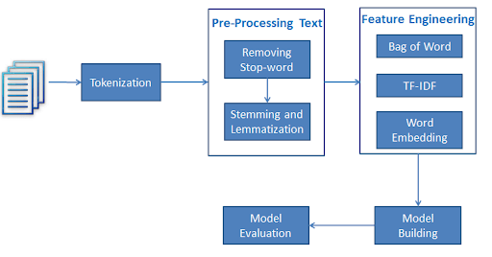


Text data analysis (classification and clustering) process
Text classification workflow
1/11/26

Slide 5
Why Dimensionality Reduction?
It is so easy and convenient to collect data
A brainstorm
Data is not collected only for data mining
Data accumulates in an unprecedented speed
Dimensionality reduction is an effective approach to downsizing data
An impromptu experiment:
Feel free to write down the most relevant words/phrases describing this lecture hall or classroom;
A summary of the words/phrases;
Possible tasks of using these words/phrases (Differentiate this kind of rooms from others, Characterize all similar rooms)
1/11/26
Notes:
An impromptu experiment: Feel free to write down the most relevant words/phrases describing this lecture hall or classroom; A summary of the words/phrases; Possible tasks of using these words/phrases (Differentiate this kind of rooms from others, Characterize all similar rooms)

Slide 6
Why Dimensionality Reduction?
Most machine learning and data mining techniques may not be effective for high-dimensional data.
Query accuracy and efficiency degrade rapidly as the dimension increases.
The intrinsic dimension may be small.
For example, the number of genes responsible for a certain type of disease may be small.
1/11/26

Slide 7


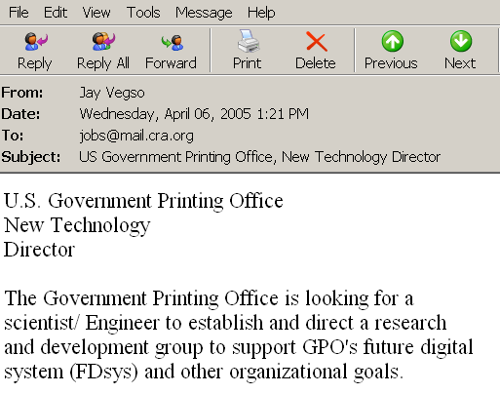

Why Dimensionality Reduction? (Application on Text Classification)
Web Pages
Terms
Emails
T₁ T₂ ….…… T_{N}
C
D₁
12 0 ….…… 6
Sports
D₂
3 10 ….…… 28
Travel
Documents
…
…
…
…
D_{M}
0 11 ….…… 16
Jobs
Internet
Task: To classify unlabeled documents into categories
Challenge: thousands of terms
Solution: to apply dimensionality reduction
ACM Portal
IEEE Xplore
PubMed
Digital Libraries
1/11/26

Slide 8
Major Techniques of Dimensionality Reduction
Feature extraction (reduction)
Definition
Objectives
Feature selection
Definition
Objectives
What are the differences between feature extraction and feature selection?
1/11/26

Slide 9
2
Feature extraction and
selection
1/11/26

Slide 10

Feature extraction & selection
Extraction: Getting useful features from existing data.
Selection: Choosing a subset of the original pool of features.
1/11/26

Slide 11
Feature extraction & selection
Goal of Extraction: it builds valuable information from raw data – the features – by reformatting, combining, transforming primary features into new ones… until it yields a new set of data that can be consumed by the Machine Learning models to achieve their goals.
Goal of Selection: is applied either to prevent redundancy and/or irrelevancy existing in the features or just to get a limited number of features to prevent from overfitting.
1/11/26

Slide 12
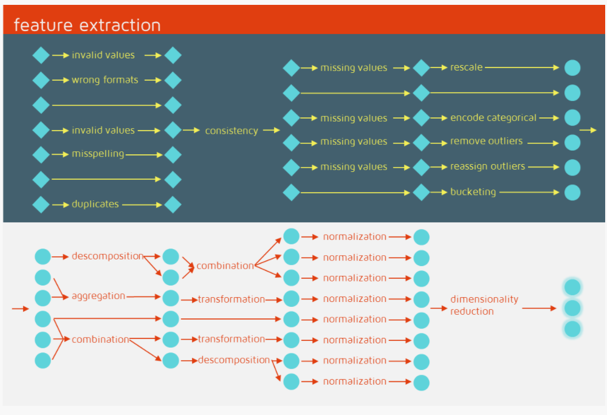
Feature extraction method
1/11/26

Slide 13
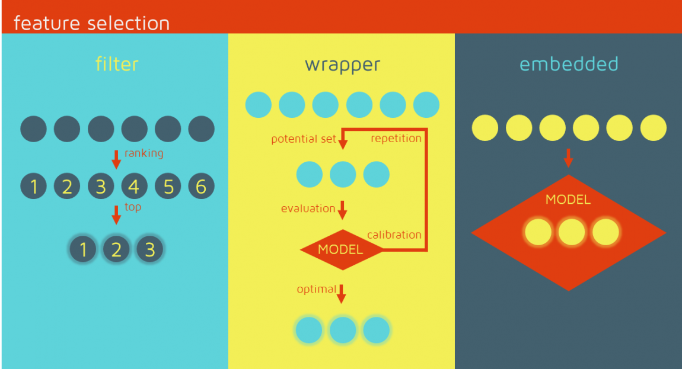
Feature selection method
1/11/26

Slide 14
Question
How can we get the original features from textual data?
1/11/26

Slide 15
3
Document representation
1/11/26

Slide 16
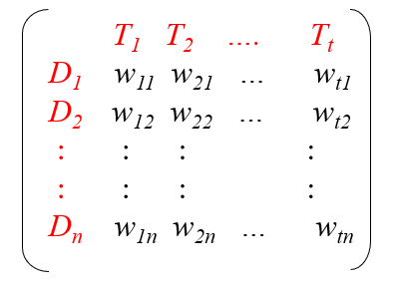
Document collection
A collection of n documents can be represented in the vector space model by a term-document matrix.
An entry in the matrix corresponds to the “weight” of a term in the document; zero means the term has no significance in the document or it simply doesn’t exist in the document.
1/11/26

Slide 17
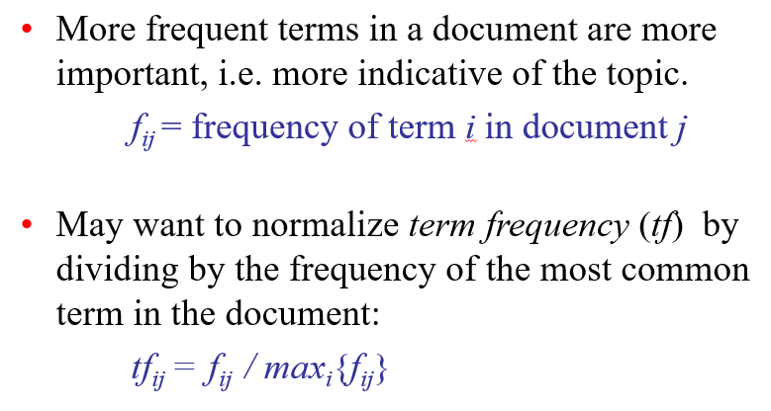
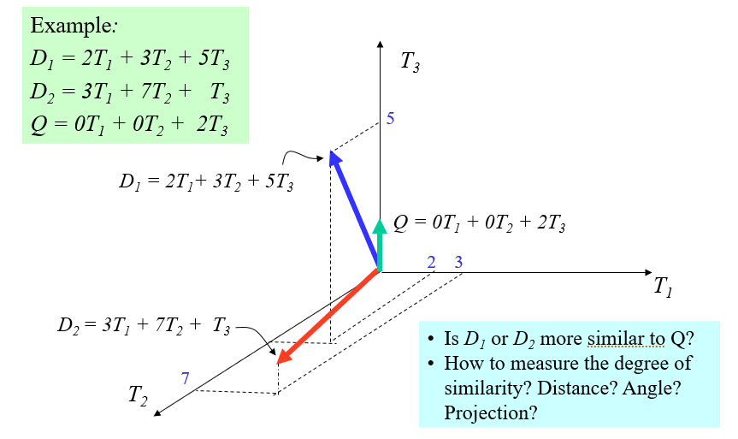
Using word-level features – term frequency
What are the drawbacks?
1/11/26

Slide 18
Using word-level features – tfidf (Term Frequency)
1/11/26

Slide 19
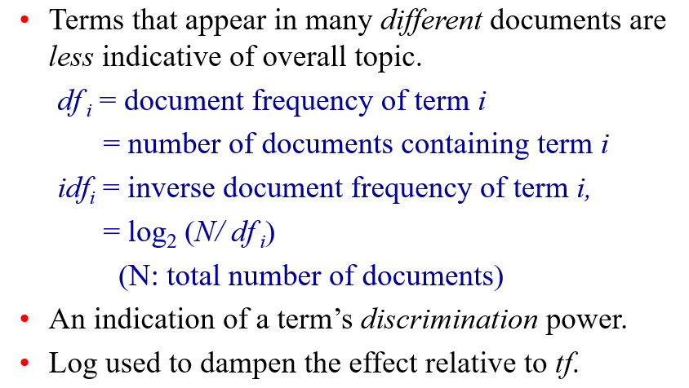
Using word-level features – tfidf (Inverse Document Frequency)
1/11/26

Slide 20
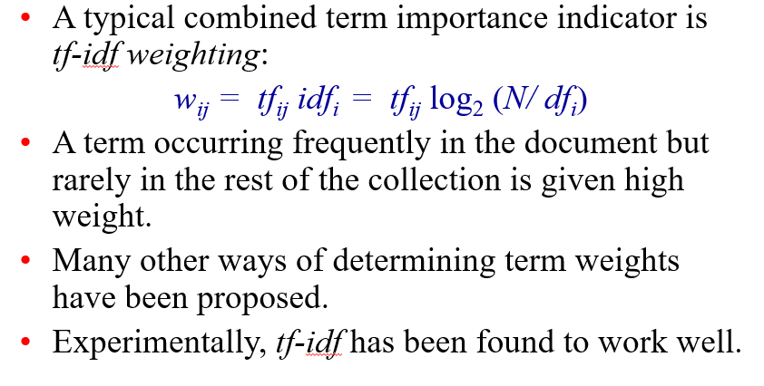
Using word-level features – tfidf
What are the drawbacks?
1/11/26

Slide 21
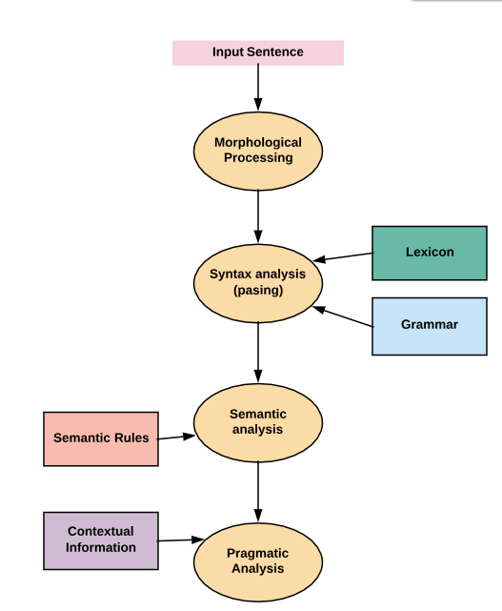
Sentence-level feature
1/11/26

Slide 22
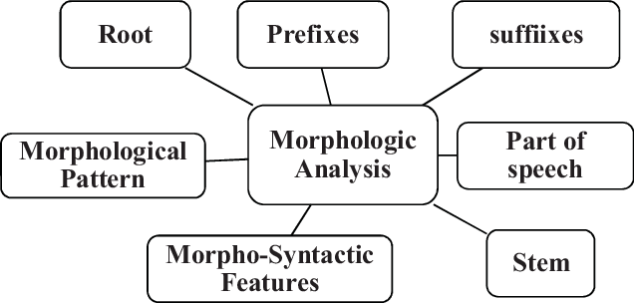
Sentence-level feature - Morphological Analysis
Morphological Analysis: the process of providing grammatical information about the word based on properties of the morpheme it contains. It is an integral part of the larger natural language processing projects such as text to speech synthesis, information extraction and machine translation.
1/11/26

Slide 23
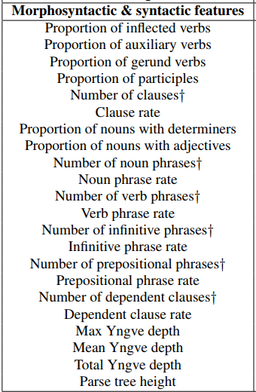
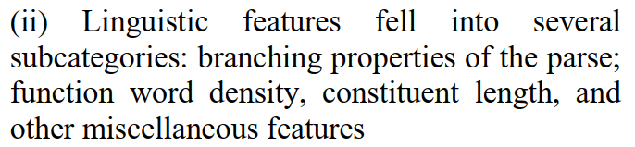
Sentence-level feature - Morphological Analysis
Morphological Features: Morphosyntactic features derived from constituency parse tree.
[2] Corston-Oliver, S., Gamon, M., & Brockett, C. (2001, July). A machine learning approach to the automatic evaluation of machine translation. In Proceedings of the 39th Annual Meeting of the Association for Computational Linguistics (pp. 148-155).
[1] Shivkumar, A., Weston, J., Lenain, R., & Fristed, E. (2020). BlaBla: Linguistic Feature Extraction for Clinical Analysis in Multiple Languages. arXiv preprint arXiv:2005.10219.
1/11/26

Slide 24
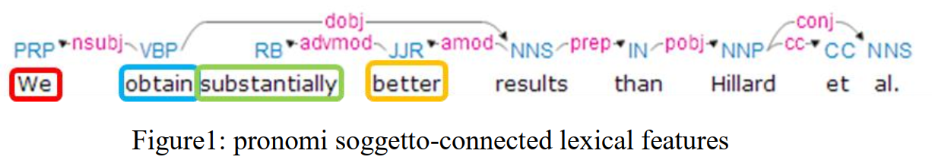
Sentence-level feature - Lexical Analysis
Lexical Analysis: is a vocabulary that includes its words and expressions. It depicts analyzing, identifying and description of the structure of words. It includes dividing a text into paragraphs, words and the sentences.
1/11/26

Slide 25
Lexical Analysis - WordNet
A large lexical database, or “electronic dictionary,” developed and maintained at Princeton
http://wordnet.princeton.edu
Includes most English nouns, verbs, adjectives, adverbs
WordNet is organized by meaning: words in close proximity are semantically similar
WordNet gives information about two fundamental, universal properties of human language: polysemy and synonymy
Can be used by humans and machines
Princeton WordNet is for English only, but it is linked to wordnets is many other languages
1/11/26

Slide 26
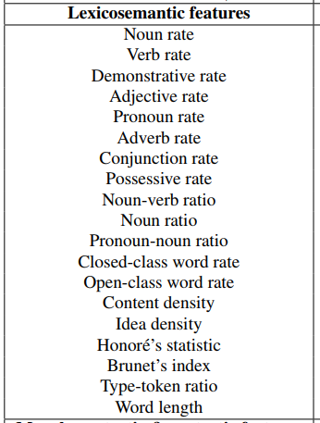
Sentence-level feature - Lexical Analysis
Lexical features: Lexicosemantic features derived from dependency parse tree.
[1] Shivkumar, A., Weston, J., Lenain, R., & Fristed, E. (2020). BlaBla: Linguistic Feature Extraction for Clinical Analysis in Multiple Languages. arXiv preprint arXiv:2005.10219.
1/11/26

Slide 27
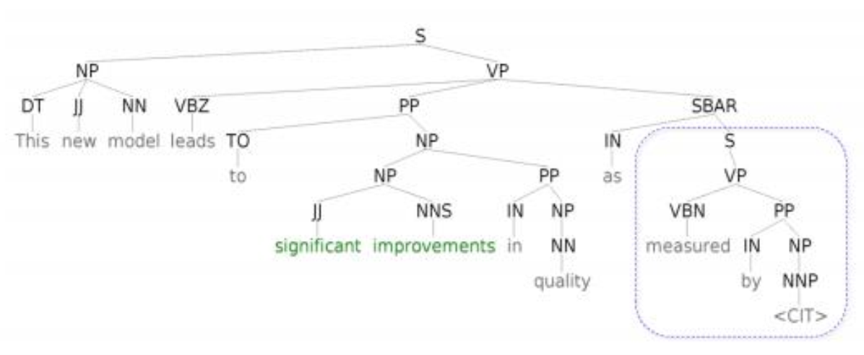
Sentence-level feature - Syntax analysis
Syntax analysis: involves analysis of words in the sentence for grammar and arranging words in a manner that shows the relationship among the words. The sentence such as “The school goes to boy” is rejected by English syntactic analyzer. Syntactic features derived from constituency parse tree.
1/11/26

Slide 28
Sentence-level feature - Syntax analysis
Syntax analysis: Syntactic features derived from constituency parse tree.
[1] Shivkumar, A., Weston, J., Lenain, R., & Fristed, E. (2020). BlaBla: Linguistic Feature Extraction for Clinical Analysis in Multiple Languages. arXiv preprint arXiv:2005.10219.
1/11/26

Slide 29
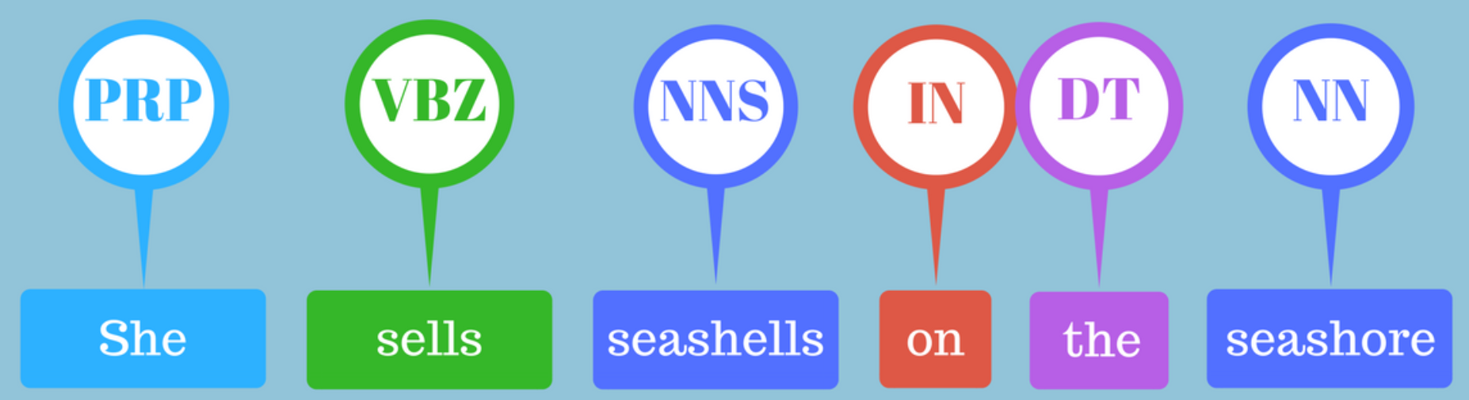
Sentence-level feature - POS tagging
POS tagging: make a prediction of which tag or label most likely applies in this context. A model consists of binary data and is produced by showing a system enough examples for it to make predictions that generalize across the language – for example, a word following “the” in English is most likely a noun.
1/11/26

Slide 30
Sentence-level feature - Discourse Analysis
Discourse analysis looks at conversations in their social context.
Discourse analysis melds linguistics and sociology by taking into account the social and cultural context that language is used.
Discourse analysis including discourse during a political debate, discourse in advertising, television programming/media, interviewing, and storytelling. By looking at the context of language use, not simply the words, we can understand nuanced layers of meaning that are added by the social or institutional aspects at work, such as gender, power imbalance, conflicts, cultural background, and racism.
Scientific discourse annotation schemes which define classes such as Hypothesis, Method and Result for Core Scientific Concepts and Background/ Own/Contrast.
Unlike grammar analysis, which focuses on the structure of sentences, discourse analysis focuses on the broad and general use of language within and between particular groups of people.
[3] Duma, D. C. (2019). Contextual citation recommendation using scientific discourse annotation schemes (Doctoral dissertation, University of Edinburgh).
1/11/26

Slide 31

Sentence-level feature - Discourse Analysis
Discourse features
[1] Shivkumar, A., Weston, J., Lenain, R., & Fristed, E. (2020). BlaBla: Linguistic Feature Extraction for Clinical Analysis in Multiple Languages. arXiv preprint arXiv:2005.10219.
1/11/26

Slide 32
Other features
Statistic information
Position information
Rule-based features
What are other features can be extracted from text?
What are the drawbacks?
[2] Corston-Oliver, S., Gamon, M., & Brockett, C. (2001, July). A machine learning approach to the automatic evaluation of machine translation. In Proceedings of the 39th Annual Meeting of the Association for Computational Linguistics (pp. 148-155).
1/11/26

Slide 33
Semantic analysis
Semantics focuses only on the literal meaning of words, phrases, and sentences. This only abstracts the dictionary meaning or the real meaning from the given context. The structures assigned by the syntactic analyzer always have assigned meaning. For example, “I have a green idea” be rejected by the semantic analysis since “green doesn't make any sense”.
1/11/26

Slide 34
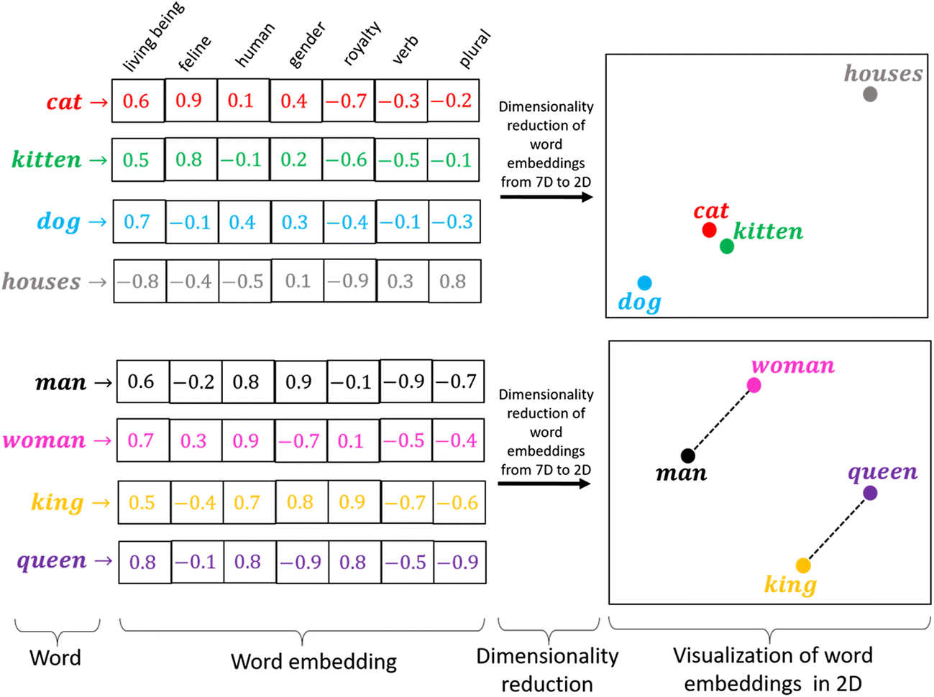
Word Embeddings
A word embedding is a learned representation for text where words that have the same meaning have a similar representation.
It is this approach to representing words and documents that may be considered one of the key breakthroughs of deep learning on challenging natural language processing problems.
1/11/26
Notes:
Word embeddings are in fact a class of techniques where individual words are represented as real-valued vectors in a predefined vector space. Each word is mapped to one vector and the vector values are learned in a way that resembles a neural network, and hence the technique is often lumped into the field of deep learning.
Key to the approach is the idea of using a dense distributed representation for each word.
Each word is represented by a real-valued vector, often tens or hundreds of dimensions. This is contrasted to the thousands or millions of dimensions required for sparse word representations, such as a one-hot encoding.
associate with each word in the vocabulary a distributed word feature vector … The feature vector represents different aspects of the word: each word is associated with a point in a vector space. The number of features … is much smaller than the size of the vocabulary

Slide 35
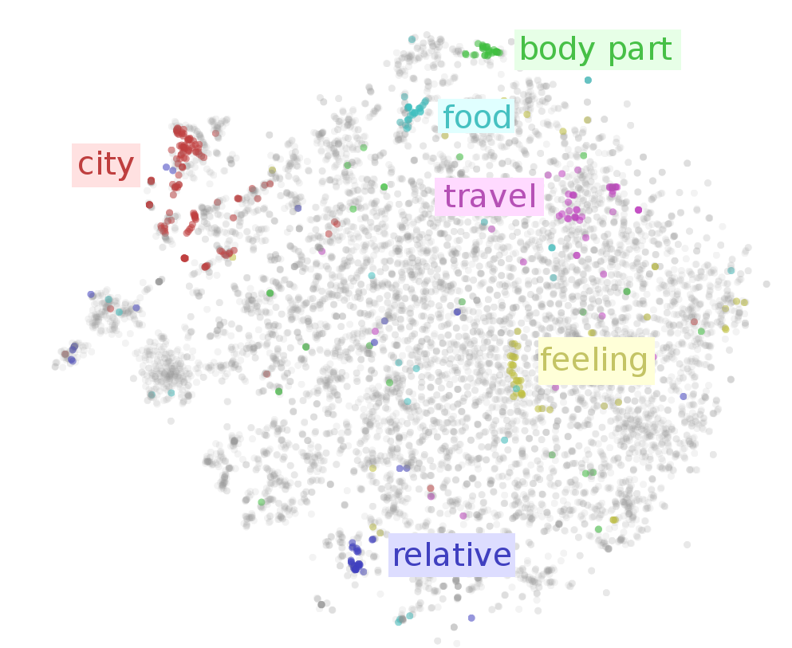
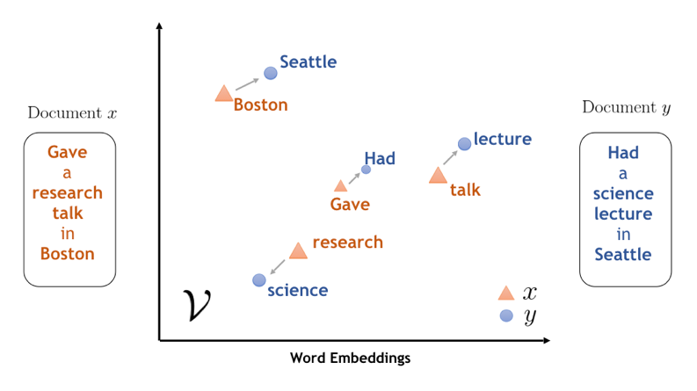
Word Embeddings
1/11/26

Slide 36
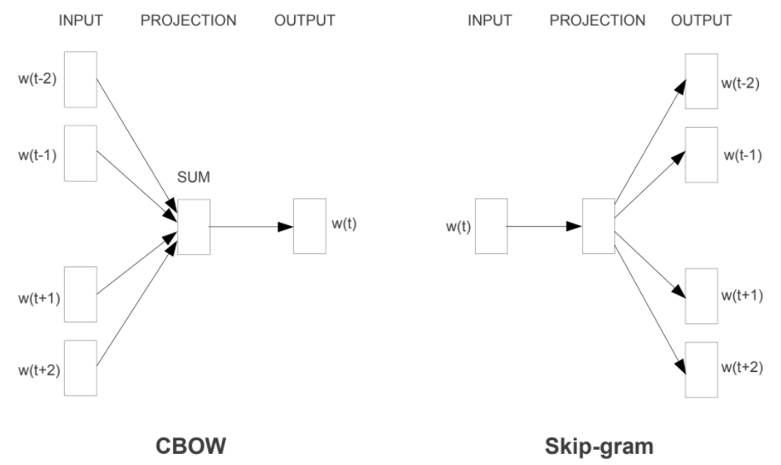
Word Embeddings – word2vec
Word2Vec is a statistical method for efficiently learning a standalone word embedding from a text corpus.
The CBOW model learns the embedding by predicting the current word based on its context. The continuous skip-gram model learns by predicting the surrounding words given a current word.
1/11/26
Notes:
learns word representations from local context windows. Static word embedding. the polysemous word bank has two meanings, but word embedding cannot distinguish the two meanings when encoding the word bank. Although the words in the context are the same, in language model training, no matter what context sentences pass through Word2vec, they all predict the same word bank, and the same word occupies the same line of parameter space, which leads to two different contextual information encoding into the same word embedding space. Therefore, word embedding can not distinguish the different semantics of polysemy, which is a serious problem.

Slide 37
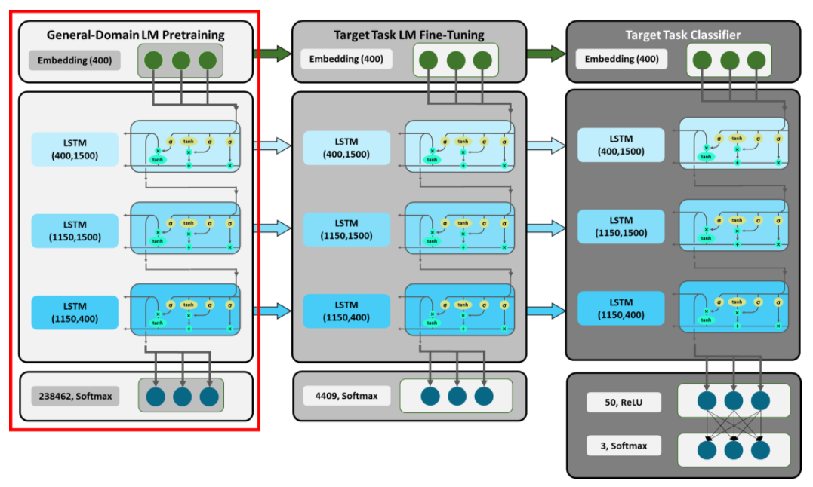
Word Embeddings – Universal Language Model Fine-tuning (ULMFiT)
1/11/26
Notes:
https://humboldt-wi.github.io/blog/research/information_systems_1819/group4_ulmfit/

Slide 38
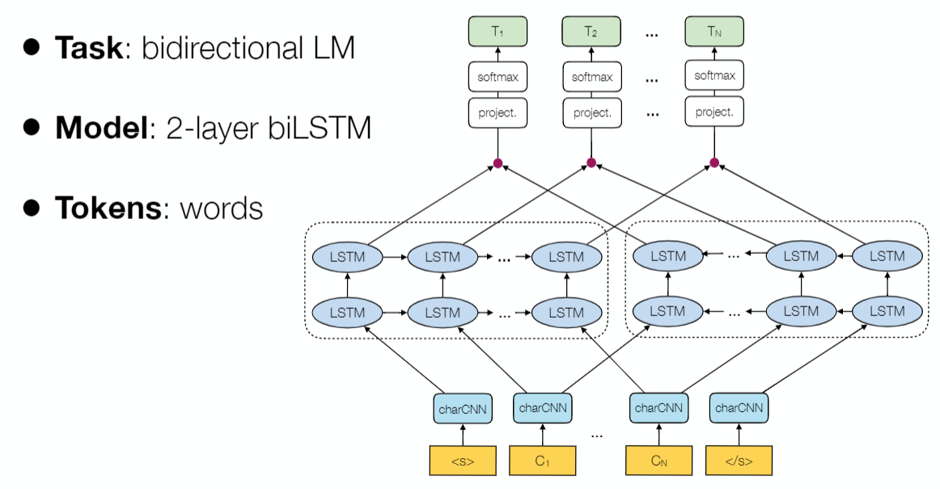
Word Embeddings – ELMO
1/11/26
Notes:
https://www.analyticsvidhya.com/blog/2019/03/learn-to-use-elmo-to-extract-features-from-text/

Slide 39
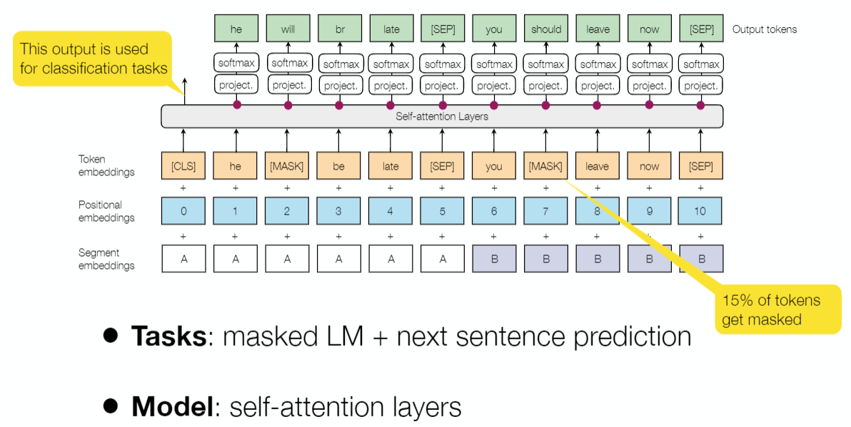
Word Embeddings – BERT
1/11/26
Notes:
https://towardsdatascience.com/bert-explained-state-of-the-art-language-model-for-nlp-f8b21a9b6270
http://jalammar.github.io/illustrated-bert/

Slide 40
Next direction of document representation
Training on more data?
Domain specific text representation?
Transfer learning?
Graph Neural Network?
1/11/26

Slide 41
4
Python for feature extraction
1/11/26

Slide 42
Python for feature extraction - Bag-of-Words and tfidf
Collected text files → processed/normalized text data → extracted features → model
Tutorial: Text Processing and Feature Extraction for Quantitative Text Analysis
Link: http://dsspace.wzb.eu/pyug/text_proc_feature_extraction/
1/11/26

Slide 43
Python for feature extraction - Linguistic Features
Linguistic Features with Spacy Tutorial:
Link: https://spacy.io/usage/linguistic-features
A Python package for clinical linguistic feature extraction in multiple languages:
Link: https://github.com/novoic/blabla
https://github.com/novoic/blabla/tree/master/blabla/sentence_processor
1/11/26

Slide 44
Python for feature extraction – Word2Vec
Exploring Word2Vec:
Link: https://github.com/lutzhamel/word2vec-simplified/blob/master/Exploring%20Word2Vec.ipynb
Gensim Word2Vec Tutorial:
Link: https://www.kaggle.com/pierremegret/gensim-word2vec-tutorial
1/11/26

Slide 45
Python for feature extraction – ULMFIT, ELMO, and BERT
ULMFIT:
https://humboldt-wi.github.io/blog/research/information_systems_1819/group4_ulmfit/
ELMO:
https://www.analyticsvidhya.com/blog/2019/03/learn-to-use-elmo-to-extract-features-from-text/
BERT:
https://github.com/huggingface/transformers
1/11/26

Slide 46
Top 10 Python Libraries for Natural Language Processing
2018 version:
https://kleiber.me/blog/2018/02/25/top-10-python-nlp-libraries-2018/
2020 version:
https://kleiber.me/blog/2020/08/26/top-10-python-nlp-libraries-2020/
Based on the GitHub data
1/11/26

Slide 47
Thank you
1/11/26

